Slide 1
welcome
To My
Presentation

Slide 2


BANO QABIL
Skills for a better future

Slide 3
Introduction to me
Name | Muhammad Umer
Instructor | Mam Maryam
Class | Essential of Computing
Batch | (Mon-Tues)
Assignment | Final Project (Bano Qabil)

Slide 4
Introduction
Bano Qabil is a large-scale educational initiative aimed at equipping youth with high-demand digital and technical skills through free, structured training programs.
Bano Qabil is a youth-focused learning initiative offering free, industry-relevant IT courses to help students gain employable digital skills and build sustainable careers.

Slide 5
Importance
Encourages young people to become financially independent at an early age.
Hands-on, project-based learning inspires students to create apps, websites, and digital solutions.
Students can earn through freelancing, remote jobs, or local industry roles after completing courses.
Offers completely free training, allowing students from all backgrounds to access quality IT education.
Helps build a strong, tech-skilled workforce that contributes to the country’s digital economy.

Slide 6
Courses Offered
Essential of Computing
Graphic Designing Essential
Vedio Editing
Web Developement
Digital Marketing
E-Commerce

Slide 7
Institute features
Professional trainers with real industry experience guide students with practical knowledge.
All courses are completely free, making quality IT training available for everyone.
Equipped with computers, projectors, and updated software for hands-on learning. Students work on real projects to build strong portfolios and gain confidence.
Students work on real projects to build strong portfolios and gain confidence.
Friendly instructors and staff create a motivating and comfortable atmosphere.

Slide 8
Power ponit tools I learned
Understanding ribbons, tabs, and workspace layout.
Adding new slides, choosing layouts, and organizing content.
Fonts, colors, alignment, spacing, bullets, and numbering.
Adding images, shapes, icons, SmartArt, charts, and videos.
Applying themes, variants, and using the Designer tool for professional layouts.
Adding entrance, emphasis, and exit animations with smooth slide transitions.

Slide 9
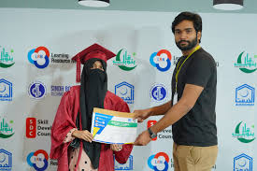
Student achievements
Students successfully mastering digital and technical skills.
Creation of real-world assignments, presentations, and practical projects.
Enhanced computer skills, software handling, and online productivity.
Students receive recognized certificates upon course completion.

Slide 10
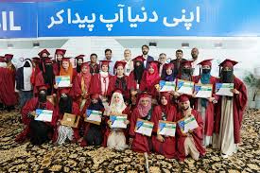
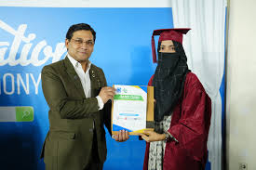
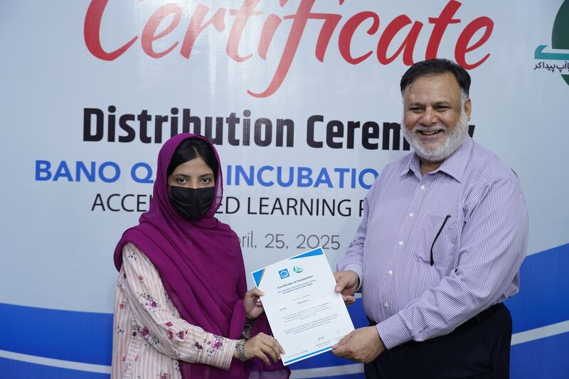
More achievements

Slide 11
Impact on youth
Equips youth with digital, technical, and professional skills.
Prepares young people for jobs, freelancing, and entrepreneurship.
Enhances self-esteem through learning and achieving goals.
Motivates youth to create projects, start initiatives, and solve problems.
Fosters teamwork, communication, and responsible digital behavior.

Slide 12
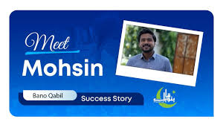
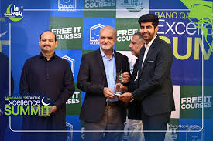
Success stories

Slide 13
Future goals
Introduce more advanced digital, technical, and creative courses for youth.
Increase access for rural and underprivileged youth.
Offer mentorship, internships, and job placement opportunities.
Encourage youth-led startups and small business initiatives.
Integrate online learning, workshops, and interactive projects.

Slide 14




Contact information
www.banoqabil.org
0342-5432516
@BanoQabil
Fateh sher Road Sahiwal

Slide 15
Thank you
Presented By Muhammad Umer

